Slide 1

FUNDAMENTAL DUTIES

Slide 2

To abide by the constitution and to respect ideals of constitution and institutions, the National Flag and the National Anthem.

Slide 3

2. To cherish and follow the noble ideals which inspired our national struggle for freedom.

Slide 4

3. To uphold and protect the sovereignty, unity and integrity of India.

Slide 5

TEN FUNDANMANTAL DUTIES
4. To defend the country and render national service when called upon to do so.

Slide 6

TEN FUNDANMANTAL DUTIES
5. To promote harmony and the spirit of common brotherhood amongst all the people of India linguistic and regional or sectional diversities; to renounce practices derogatory to the dignity of women

Slide 7

TEN FUNDANMANTAL DUTIES
6. To value and preserve the rich heritage of our composite culture

Slide 8

TEN FUNDANMANTAL DUTIES
7. To protect and improve the natural environment including forests, lakes, rivers and wild life, and to have compassion for living creatures

Slide 9
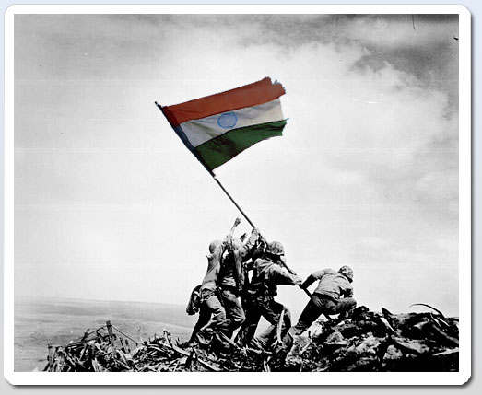
TEN FUNDANMANTAL DUTIES
8. To develop the scientific temper, humanism and the spirit of inquiry and reform.

Slide 10

TEN FUNDANMANTAL DUTIES
9. To safeguard public property and to abjure violence

Slide 11
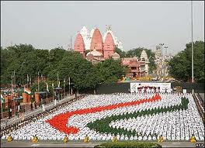
TEN FUNDANMANTAL DUTIES
10. To strive towards excellence in all spheres of individual and collective activity so that the nation constantly rises to higher levels of Endeavour and achievement.

Slide 12


Slide 13
Criticism of Fundamental Duties
No arrangement has been made for their implementation
High ideals
These should have been included in chapter III of the Constitution
Some important duties remain enumerated
Complex Language
Duties have not been linked with rights

Slide 14
Importance of Fundamental Duties
Helpful in the enjoyment of Rights
Create sense of duty
Create Patriotism
Guiding principles
Remove deficiency from the constitution
Non Controversial
Educative Significance

Slide 15
References
Badyal, J.S, Indian Government and Politics, Raj Publishers, Jalandhar, 2013.
Agarwal, R.C, Constitutional Development and National Movement of India, S. Chand& Company LTD., New Delhi, 2000.

Slide 16
References
Avasthi, A.P, Indian Government and Politics, Narain Agarwal, Agra, 2001.
Badyal, J.S, Indian Government and Politics, Raj Publishers, Jalandhar, 2013.
Fadia, B.L, Indian Government and Politics, Sahitya Bhawan Publication, Agra, 2002
Ghai, U.R, Indian Government and Politics, New Academic Publishing, Jalandhar, 2002.
Gupta, D.C, Indian Government and Politics,Vikas Publishing House, New Delhi, 1978
Johari, J.C, Indian Government and Politics, Vishal Publication, 1979.

